Slide 1



Team Aperture

Slide 2

TABLE OF CONTENTS
1. OUR TEAM
2. STAGES OF REALIZATION
3. TECHNOLOGY STACK

Slide 3
OUR TEAM
01

Slide 4

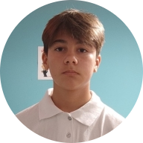
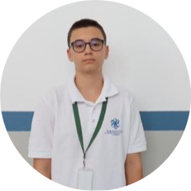
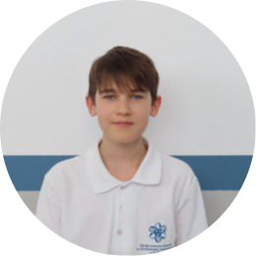
PETAR DIMITROV – 9G SCRUM TRAINER

Slide 5
MARK DIMITROV – 9G BACK-END DEVELOPER

Slide 6
HRISTIAN STANCHEV – 9V DESIGNER

Slide 7
KIRIL ZHILICHEV – 9A FRONT-END DEVELOPER

Slide 8
STAGES OF REALIZATION
02

Slide 9
STAGES OF REALIZATION
Our team wanted to embrace the idea of creating an interactive notepad designed to transform traditional note-taking into a more engaging and effective learning experience.
With Aperture Notes, users can write notes and add images to better understand topics and overcome the monotony of studying. This innovative approach makes learning more dynamic, personalized, and efficient.

Slide 10
TECHNOLOGY STACK
03

Slide 11


















TECHNO-STACK

Slide 12
Lets go to our demo
04

